Slide 1
I can’t wait to meet you!

Slide 2
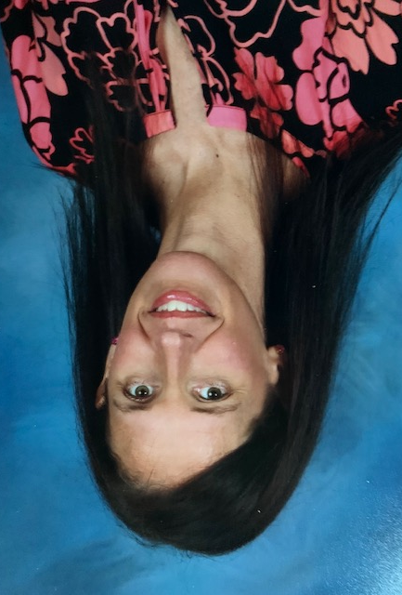
Mrs. Morgan
1st Grade
Dallas Elementary
Room 310

Slide 3
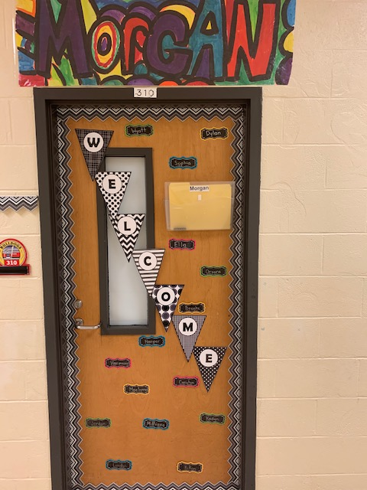
Our room is on the 300 hall, which is the same hall as your kindergarten class. We are the last room on the right.

Slide 4
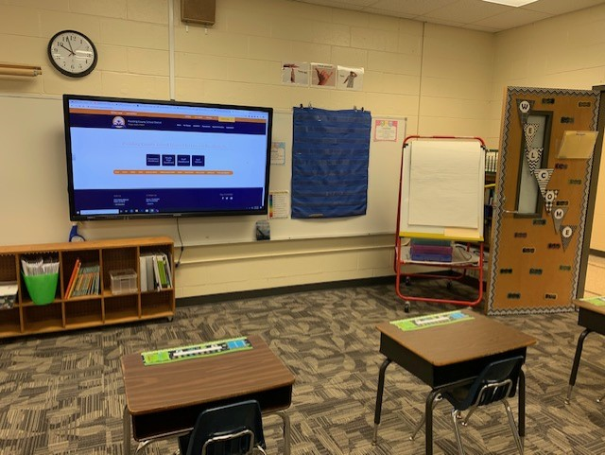
This is the front of our room where we will use the Recordex Board, do word sorts, and make charts.

Slide 5
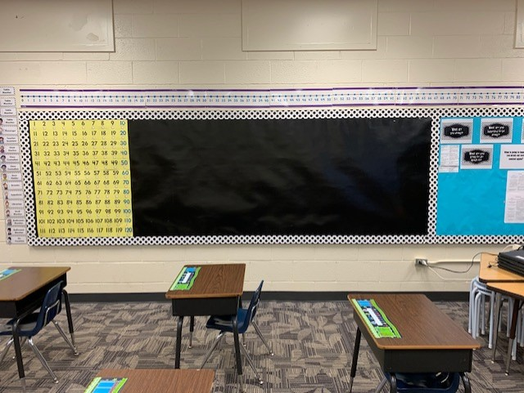
Here is one side of our room where we will keep our social contact and use math resources.

Slide 6
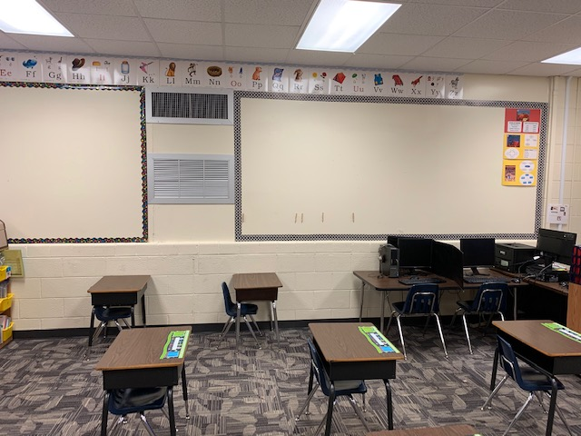
This is the other side of our room where we will have posters of every book we study this year.

Slide 7
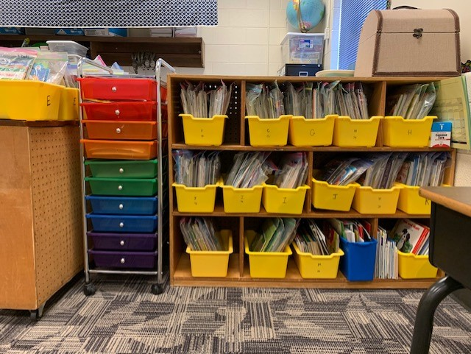
Here is our library area where you can grab a bag of books to read in your space.

Slide 8
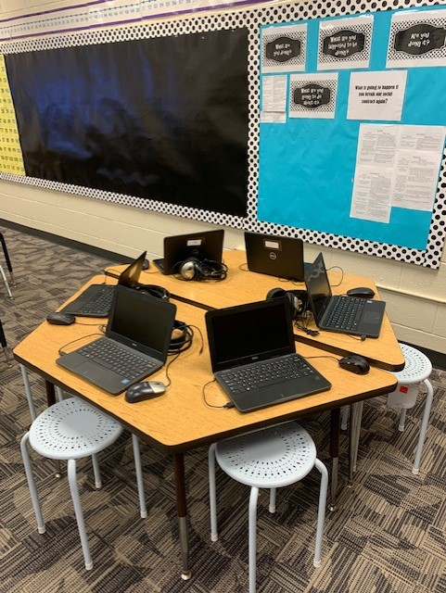
This is our table where we will eventually work in small groups.

